Slide 1

VisualiZeal Data speaks, visualization amplifies
Submitted By:
Team NIT Trichy
Mahesh Nanavare
Harshal Babar

Slide 2
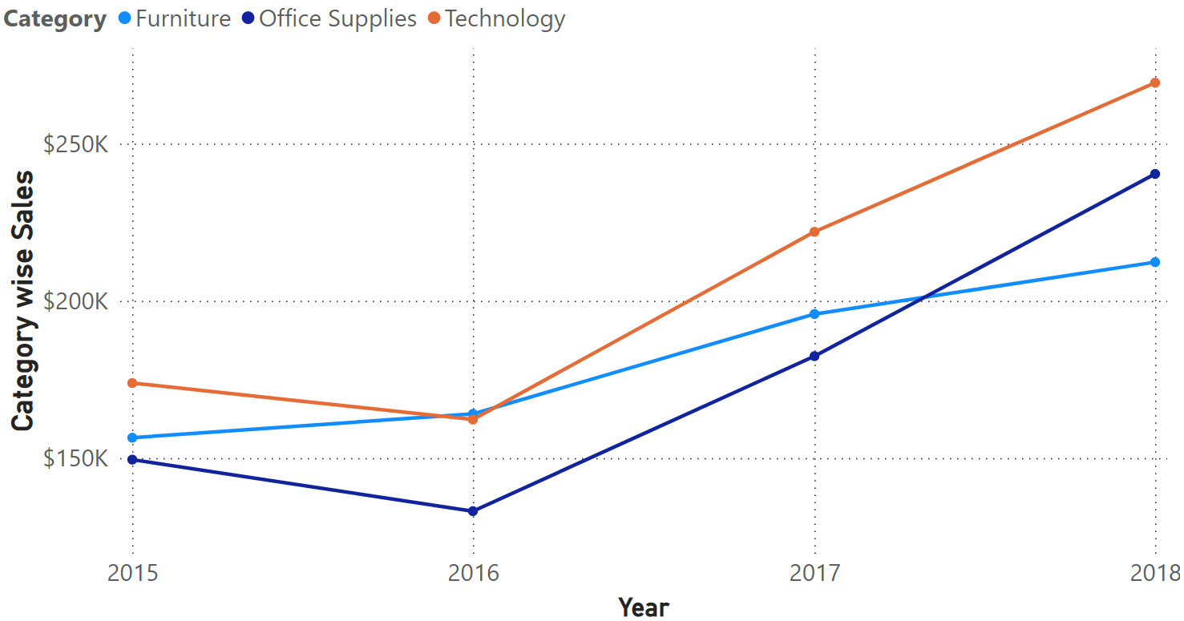
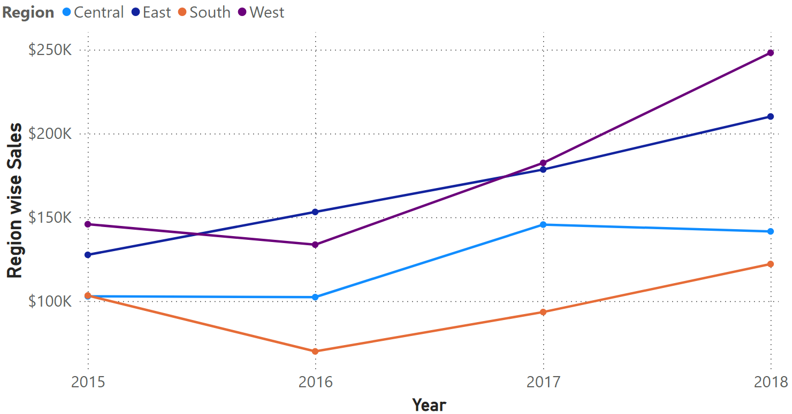
How has the sales trend evolved for each region and product category over the past years?

Slide 3
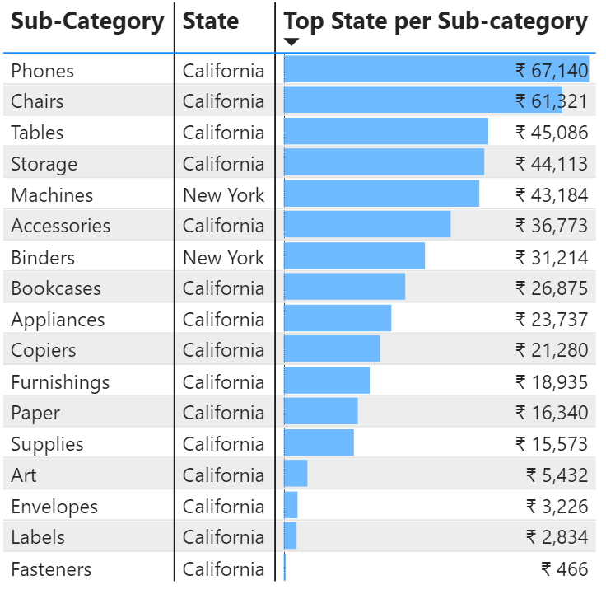
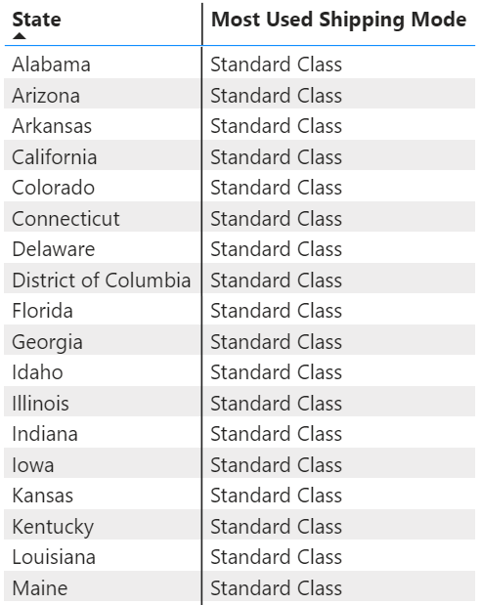
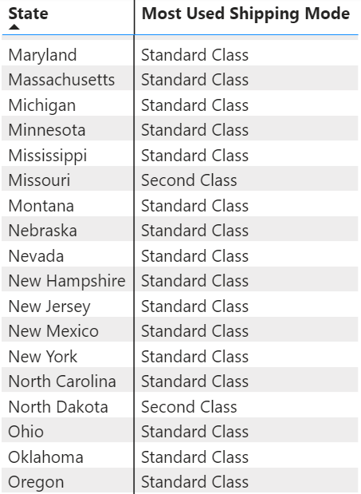
2. Which states have the highest sales for a particular sub-category of products and which shipping mode is most used in those states?

Slide 4
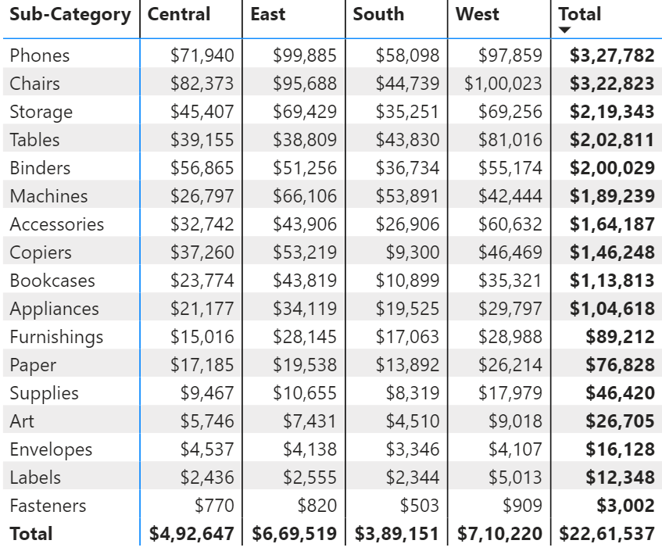
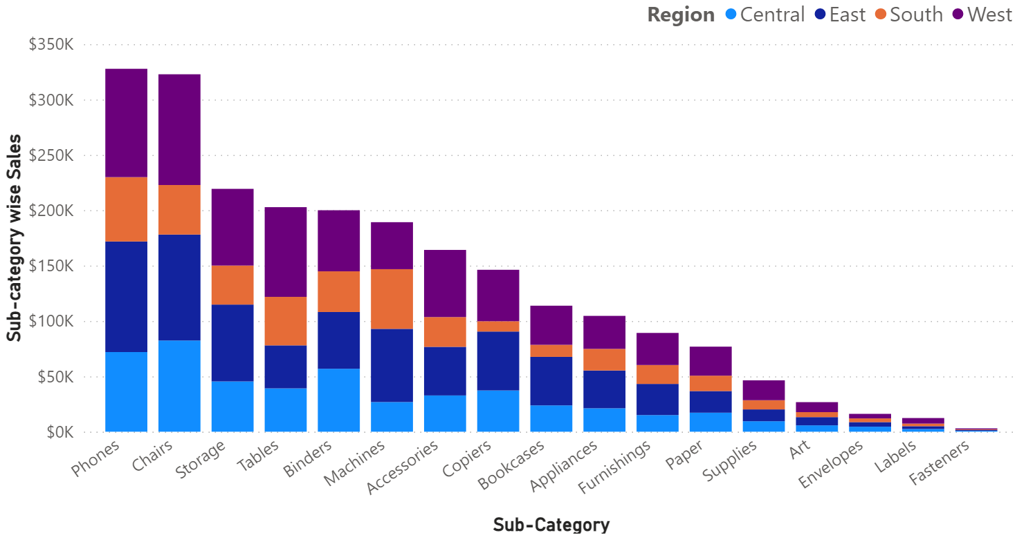
3. How does the sales performance of a particular sub-category of products vary across different regions, and how does this compare to the overall sales performance of the same sub-category of products across all regions?

Slide 5
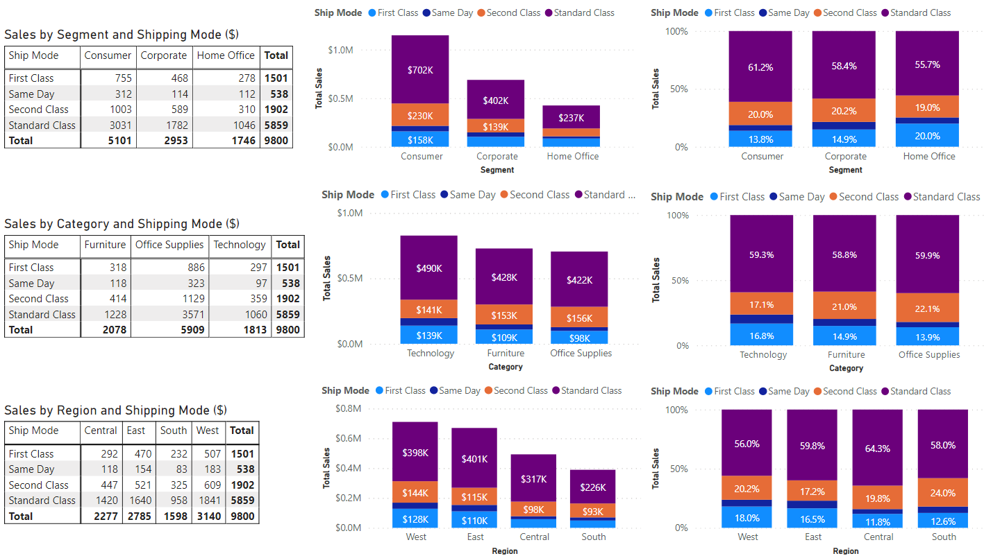
4. Can you identify any patterns or trends in the shipping modes used for orders placed in a particular segment of customers? Are these patterns consistent across different product categories and regions?

Slide 6
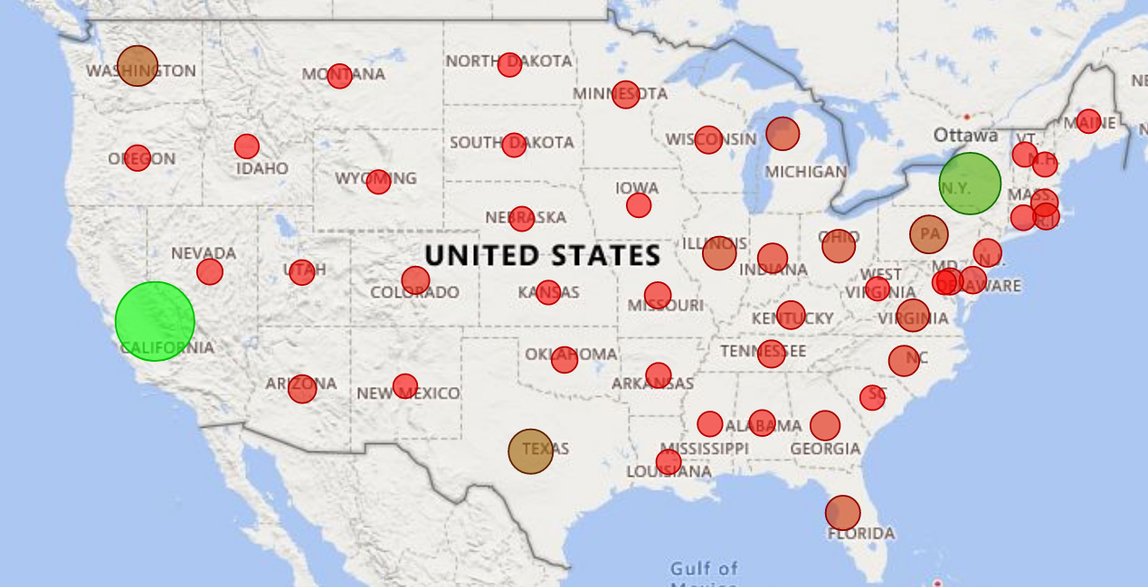
5. Can you identify any correlations between the sales performance of a particular product category and external factors such as weather patterns, economic indicators, or demographic data for the regions where the products are sold? How can this information be leveraged to optimize sales performance and customer satisfaction?

Slide 7

Thank You!

